Slide 1
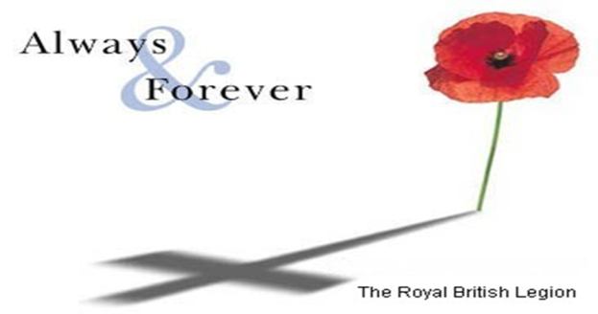
What do we remember on Poppy Day?

Slide 2
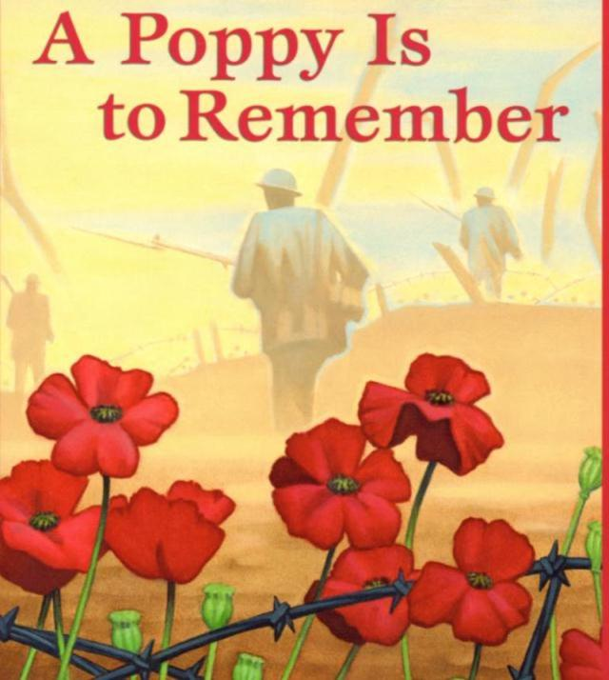

Slide 3
We remember the people who died fighting wars for their country.
It started with the First World War over 100 years ago- 1912.
Here you can see what it was like fighting a war at that time.

Slide 4
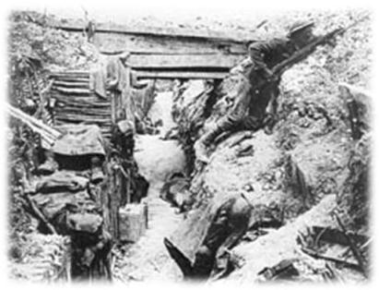
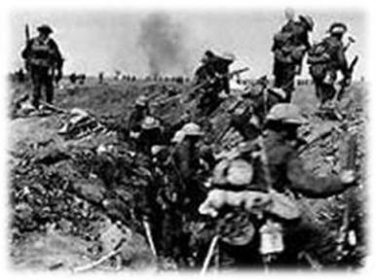
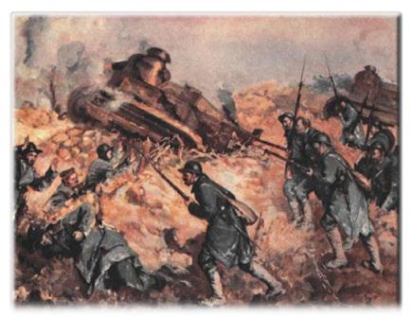

Slide 5
There have been lots of wars over the last 100 years.
On Remembrance Day we remember all those who died in those wars so that we won’t forget how brave they were.
We call them the Fallen Soldiers

Slide 6
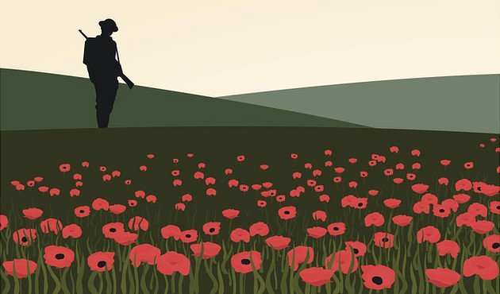
But why do we wear a poppy?
During the First World War, red poppies were the plants to spring up in the battlefields of northern France and Belgium.
The soil there allowed the poppy to grow when not much else would grow in the churned up mud.
The sight of the new growth and life of the red poppy provided a strong contrast to the death of war.

Slide 7
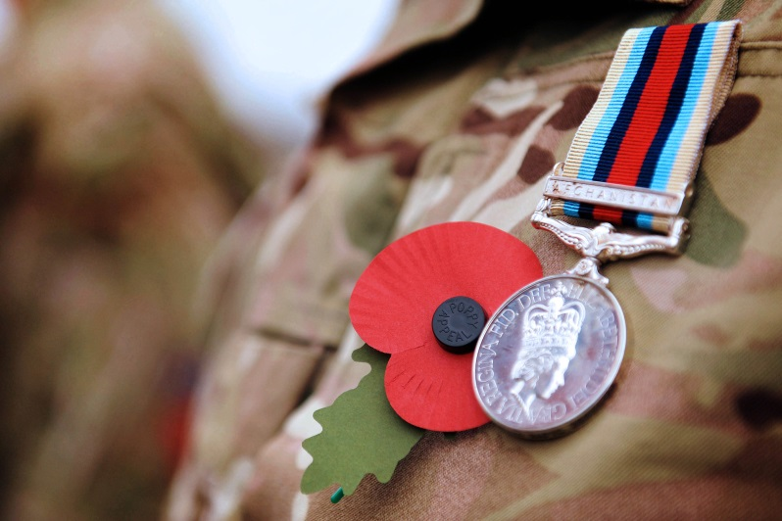
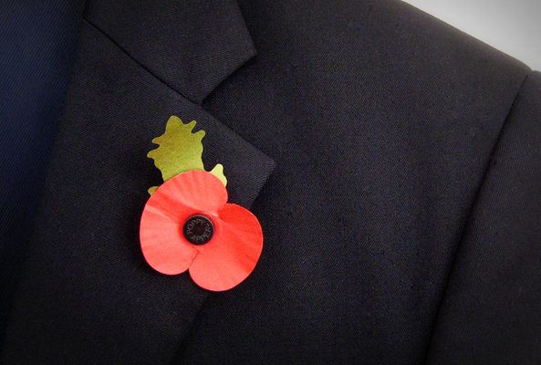
How do we remember the on Poppy day?
We wear poppies to remember the fallen soldiers because of a poem that was written nearly 100 years ago.

Slide 8
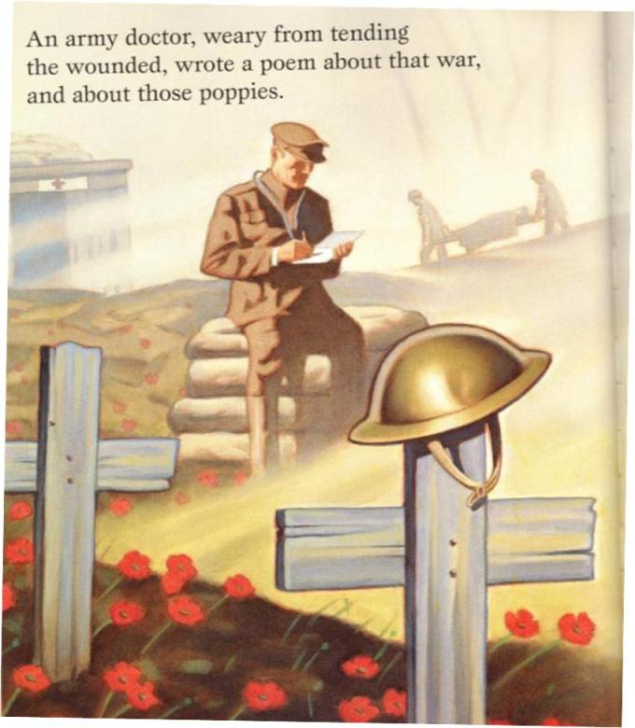

Slide 9
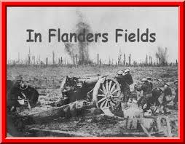
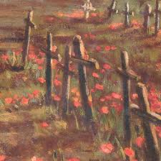

Slide 10
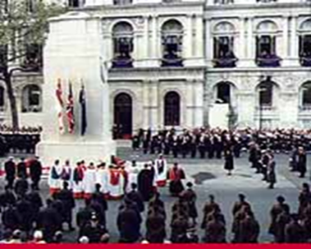
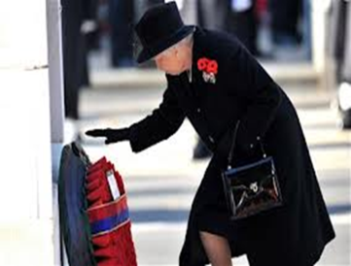
How else do we remember the soldiers who gave their lives in war?

Slide 11
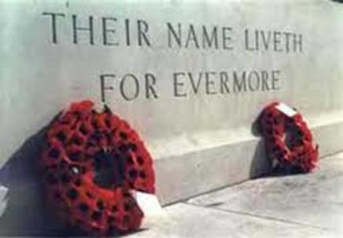
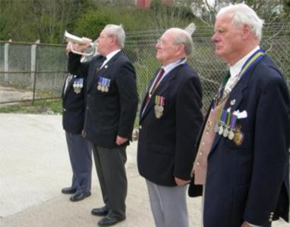
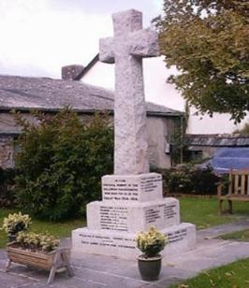
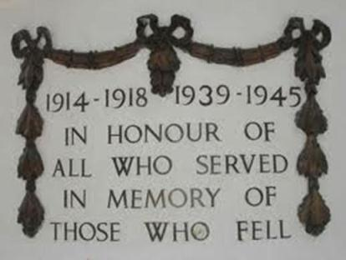

Slide 12
What do you think the writing on this memorial says?

Slide 13
So why 11th November?
The guns fell silent at the end of the First World War at a time that we use today for our two-minute silence. It was
11 o’clock on the 11th of November 1918.
We remember this as the :
eleventh hour of the
eleventh day
eleventh month

Slide 14
On Sunday, there will be a 2 minutes silence at 11 o’clock.

